Slide 1

Financial Management Software(FMS)
Financial Management Software refers to programs and those digital tools that are designed to help financial institutions and businesses.
It uses Information and Communication Technology to automate financial operations and decision-making.
Key Functions
hRole in ICT
Tax management
Budgeting
Financial reporting
Real-time data sharing
Stores and protect data
Global collaboration
Examples: Quick Books, Xero, Telly

Slide 2
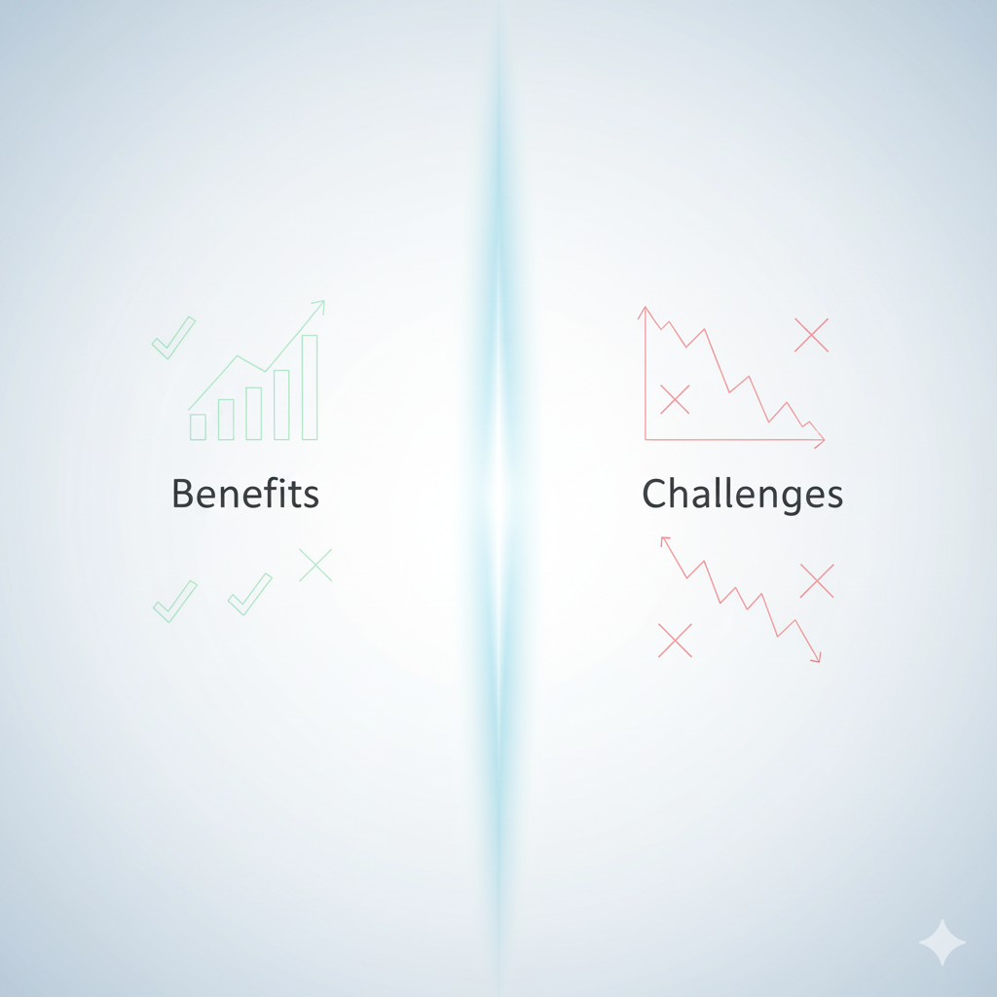
Benefits & Challenges
Benefits:
Reduces human errors
Automates repetitive tasks
Better planning insights
Saves time and cost
Anywhere at anytime access
Challenges:
Training can be expensive.
System failure concerns
Data privacy concerns
Cyber Security threats
Software needs regular updates

Slide 3

Financial Technology Services
FinTech refers to use of digital innovations to improve financial services
It is a combination of finance and technology to make investing, banking and other financial activities easier and faster.
Key Services
Role of ICT
Protect transactions
Allows banks to connect
Fraud detection tools improve security
Digital payments
Peer to Peer landing
Blockchain
Example: State Bank of Pakistan’s Raast system

Slide 4


Positive & Negative Impacts
Positive impacts
Instant Transactions
Reduces paper work
Rural payment access
Online lending and
investment
Negative impacts
High risk of hacking.
Limiting access in rural areas.
Startups some times face challenges.
Data security issues

Slide 5


Blockchain
It refers to a system that stores transactions across multiple computers.
Blockchain uses decentralization
Linked chain structure
Blocks of verified transactions
Blocks cannot be changed
Example: IBM Blockchain, Microsoft Blockchain etc.

Slide 6


Pros & Cons
Pros
Every participant can view the same transaction record.
Transactions are encrypted
Peer-to-peer transactions
Every transaction can be traced.
Cons
High energy consumption.
Public data exposure risk
Linking can be difficult
Lack technical knowledge

Slide 7


Data Analytics
Data analytics refers to use of different technologies and mathematical techniques to analyze financial data.
It uses statistics to predict future outcomes.
Use statics to predict future outcomes
Supports decision-making &
extracts useful insights
Suggests action to acheive desired goals
Example: State Bank of Pakistan, HBL, UBL etc.

Slide 8

Strengths & Limitations
Strengths
Reduce guesswork
Detect unusual transactions.
Can monitor expenses
Continuous tracking of transactions
Limitations
Incomplete data
High implementation cost.
Lack of skilled professionals.
Combining data from multiple systems is complex.

